Slide 1


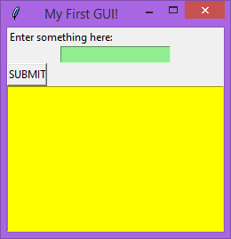
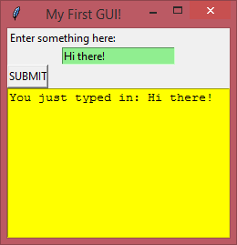
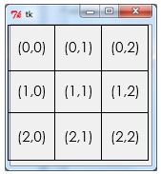
GUI Building with TKinter
Lesson 3 – more widgets

Slide 2


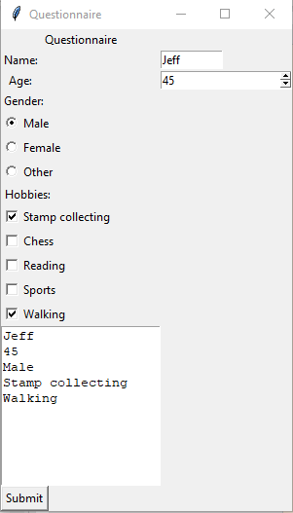
Activity 1
1 min
What widgets can you identify on this GUI program?

Slide 3
Today’s lesson
Now that we know the basics of Tkinter programming, let’s move on to adding in more advanced widgets like check boxes, spinners and radio buttons.
Most forms include a variety of different entry methods, and our program needs to be able to present the user with these different methods and handle the input that is given using variables.
Learning Objectives:
Understand the functions of spin-boxes, check boxes and radio buttons.
Understand how these can be generated in Python.
Understand the importance of tkinter variables in retrieving the values of these widgets.
Understand how to process the values from these widgets.

Slide 4
Tkinter – more widgets
Spinbox Widget
Sometimes you may wish to create a way for the user to enter a number (either an integer or a decimal) and have the option to increase /decrease the values by a predetermined amount. To do this tkinter offers a spinbox widget.
Creating a spinbox is done by writing the code:

Slide 5

Tkinter – more widgets
Tkinter Variables
This widget is created in a similar to the other widgets seen so far, except that this one makes use of a special variable (a tkinter variable). Notice that within the widget code ‘textvariable=v’ is written. This variable (v) is used to hold the value (from 1-10) that the spinbox is displaying. As the user changes this value in the GUI, the variable will hold the updated number accordingly.
To use a tkinter variable we first need to create one.
This is done by adding the following code before the spinbox code:

Slide 6
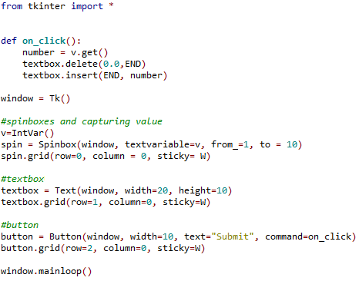
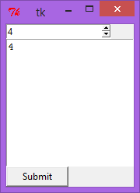
Tkinter – more widgets
Making use of the Spinbox Value
So having a spinbox and a variable to hold the value of the spinbox is a great start.
We now need to find a way to use the value in the variable. One way would be to create a function which ‘gets’ the value stored in the variable and does something with it.

Slide 7
Tkinter – more widgets
The .get() method
By studying the code above notice that the first line of the function contains a method of ‘getting’ the value of the variable (.get()). This value is then assigned to a new variable called ‘number’ which is then inserted into a textbox. Using the .get() method is way of accessing the values of spinboxes so that we can take user inputs (from this widget) and use it for processing.

Slide 8
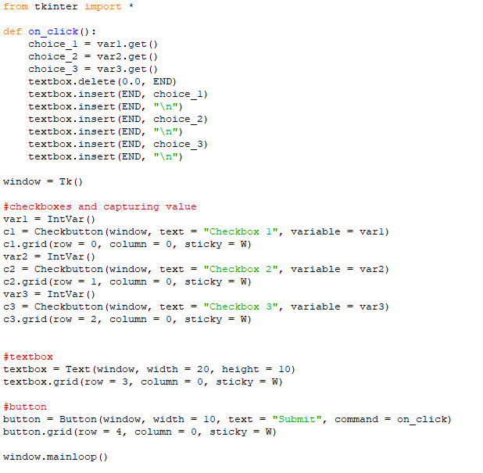
Tkinter – more widgets
The CheckBox Widget
Another useful widget is a checkbox. With a checkbox, the user can select multiple options from a list and these choices can be inputted into a program.
To create a checkbox widget we write the code:
Notice again here the creation of a tkinter variable which is to hold the state of the checkbox.

Slide 9
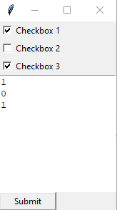
Tkinter – more widgets
The CheckBox Widget
Just like we saw with the spinbox, we can use the .get() method to retrieve the value of the checkbox.
Study the code below to see how a checkbox values can be displayed in a textbox when a button is clicked.
The function code ‘gets’ the checkbox values and inserts them into the textbox. Notice that “\n” is inserted after the first and second checkbox value. This inserts a ‘new line’ so that the following insertion appear below the previous.
As you can see the checkbox value is one of two states:
0 = checked,
1 = unchecked.

Slide 10
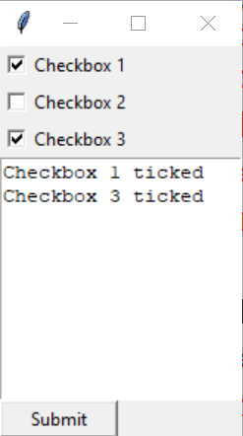
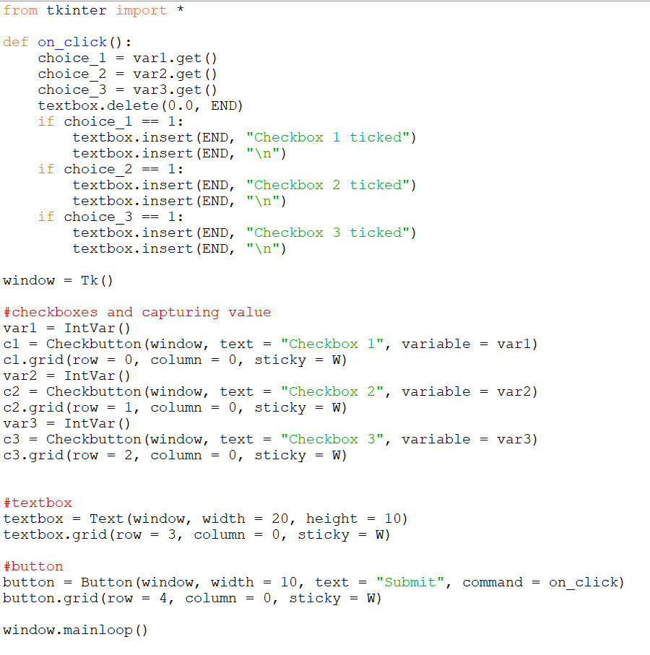
Tkinter – more widgets
The CheckBox Widget
Outputting 1s and 0s is fine for testing the value of the box, but what if we want it to represent something?
Let’s adjust the on_click function code now so that we’re outputting a string value instead of just the number.

Slide 11

Tkinter – more widgets
Radio Buttons
Similar to check boxes, radio buttons can also be created to get user inputs. But radio buttons differ in that they only allow one option from a list of options to be selected. And because of this we assign multiple radio button widgets to just one variable. Furthermore, we create only one variable to hold the value of the selected radio button.
To create a radio button we use the following code:

Slide 12

Tkinter – more widgets
Radio Buttons
You can see from the code above that a tkinter integer variable has been created and is used to hold the value of the selected radio button. Also, each radio button produced has been assigned to the same variable (“rb”). Also, we have chosen the values that each radio button represents. Because the tkinter variable created to store the radio button values is an integer variable (IntVar()), the button values must be numerical. However, if we created a tkinter variable of string data type (StringVar()), we could have a string for the value of our radio buttons:

Slide 13
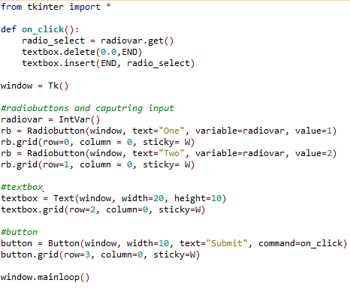
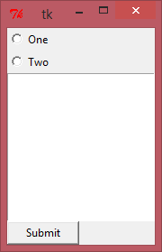
Tkinter – more widgets
Radio Buttons
As you can see from the code below, we can then use the .get() method to retrieve the value of the radio button variable. Once again, in the example given the chosen radio button’s value is simply being displayed in a text box.

Slide 14
Activity 2
45mins
Create a questionnaire which asks the user for their name (entry), age (spin box), gender (radio button) and favorite hobbies from a choice of list of ten options (checkboxes).
The program will then display this in a textbox below.
Save your work as “lesson 3 activity 2”
Extension: Research another widget – the “combobox” and see if you can include it in your questionnaire program.
Save the extension as “lesson 3 extension”

Slide 15
Uploading your work
You should now have 1 complete Python file from today’s lesson (plus any extension work). On Google classroom you will find an assignment for this lesson, and you need to upload your completed Python file to this assignment.
If you have any problems doing this, please speak to your teacher.

